Slide 1
Inserting a node into Binomial heap, Extracting the node with minimum key, Decrease a key, Deleting a key in Binomial heap.

Slide 2
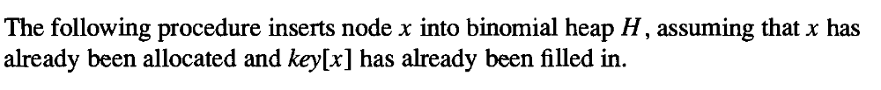
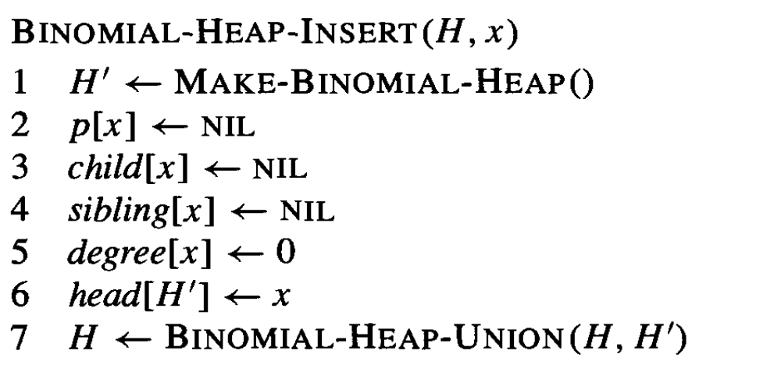
Inserting a node into Binomial heap

Slide 3
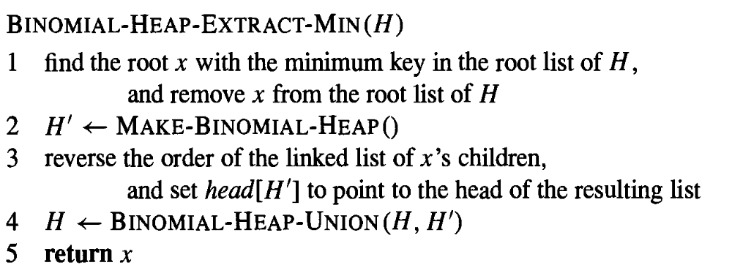
Extracting the node with minimum key

Slide 4
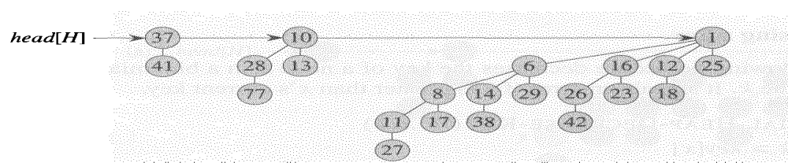
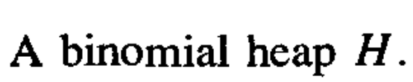
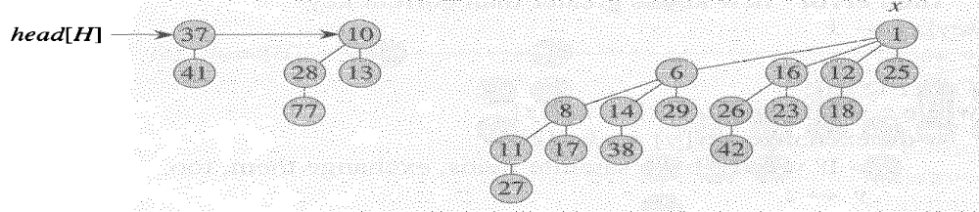
Example

Slide 5
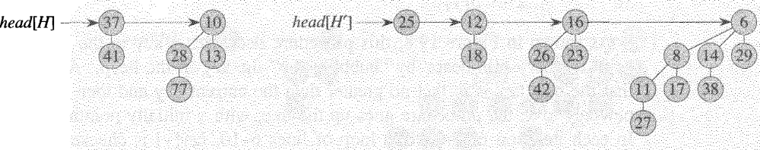
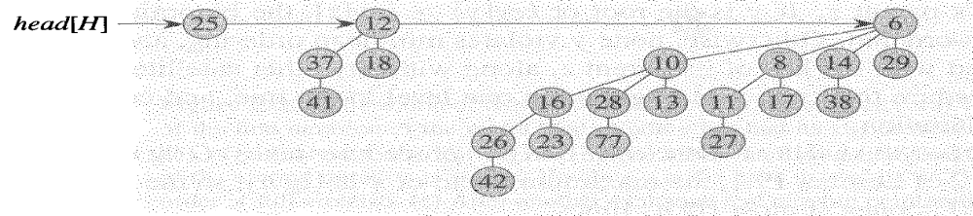
……..
The linked list of x’s children is reversed-giving another binomial heap H’

Slide 6
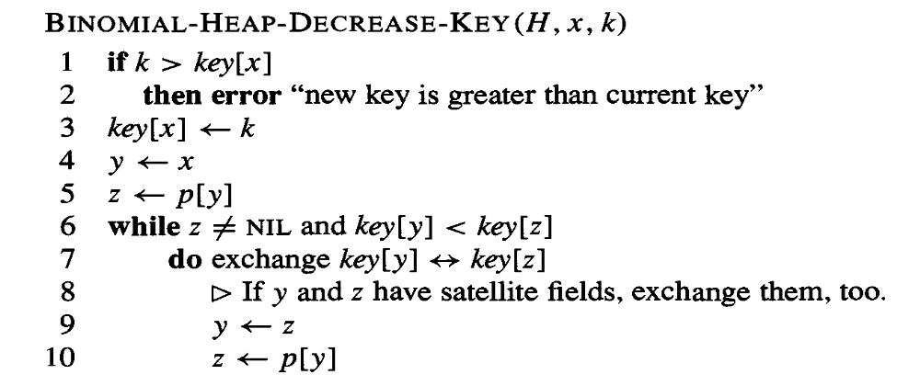
Decrease a key

Slide 7
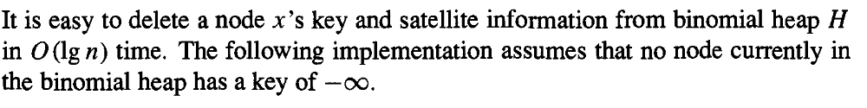
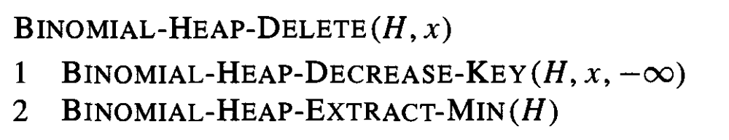
Deleting a key in Binomial heap

Slide 8
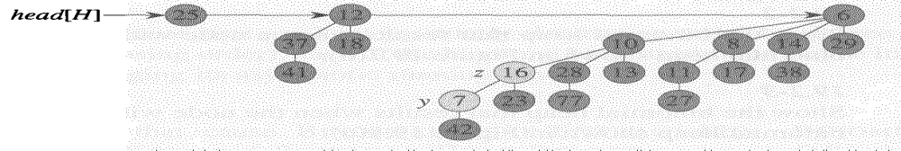
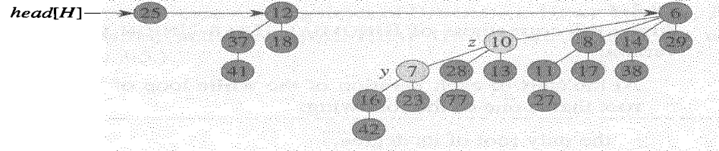
Example
Node y’s key decreased to 7

Slide 9
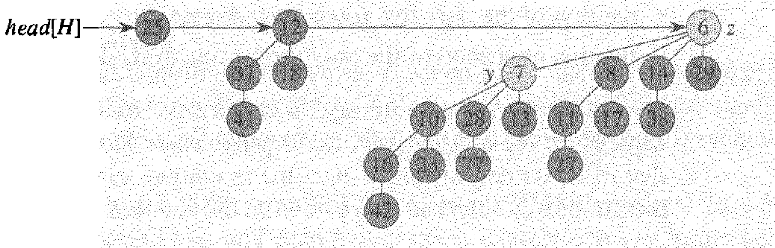
………

Slide 10
34 54 12 87 93 19 73 64 51 59 9
N=11
1011

